Slide 1
DENVar: A global Dynamic Estimate of NDVI Variance
Stefano Mezzini, Michael J. Noonan
2025-04-28
Lab update

Slide 2
Origin of remote sensing
First satellite: Sputnik 1, launched in 1957 by Soviet Union
“Passive” data collection: no need for fieldwork
Can monitor landscapes at various spatiotemporal scales
Collect light data (near infra-red, red, green, blue, LIDAR, etc.)
Can create other measures:
Normalized Difference Vegetation Index (NIR – Red) / (NIR + Red)
Enhanced Vegetation Index
Earth’s surface temperature
Human Footprint Index

Slide 3

NDVI
Normalized Difference Vegetation Index
$$NDVI=\frac{NIR −Red}{NIR+Red}$$
Measure of greenness:
Productivity
Forage availability
Phenology

Slide 4
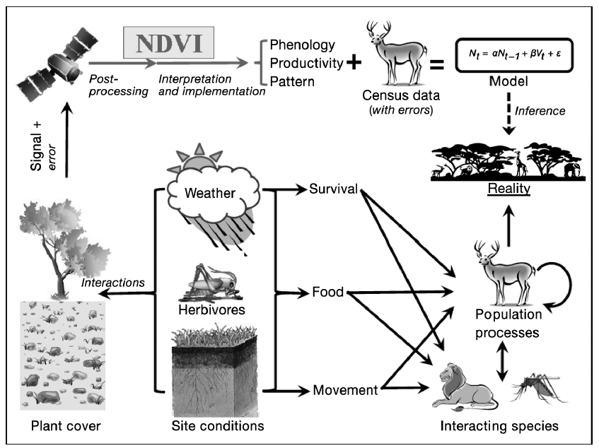
There have been many successes with NDVI
Fig. 1 of Pettorelli et al. (2011) doi.org/10.3354/cr00936

Slide 5
NDVI is a proxy of what we are interested
Fig. 1 of Pettorelli et al. (2011) doi.org/10.3354/cr00936; red box added manually

Slide 6
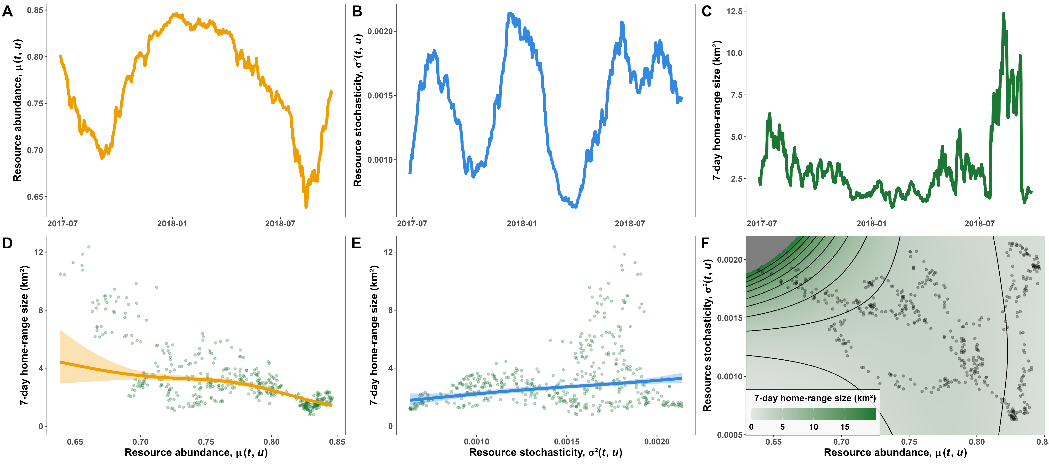

Mean NDVI is a useful proxy
Fig. 5 of Mezzini et al. (2025) https://doi.org/10.1186/s40462-025-00546-5 (edited)

Slide 7
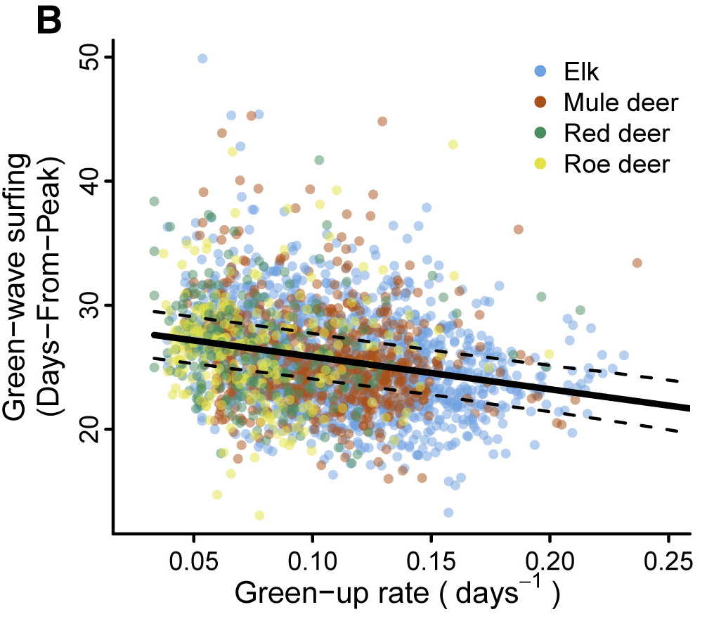
Slope of mean NDVI is a useful proxy
Fig. 2 from Aikens et al (2020) doi.org/10.1016/j.cub.2020.06.032 (cropped)

Slide 8
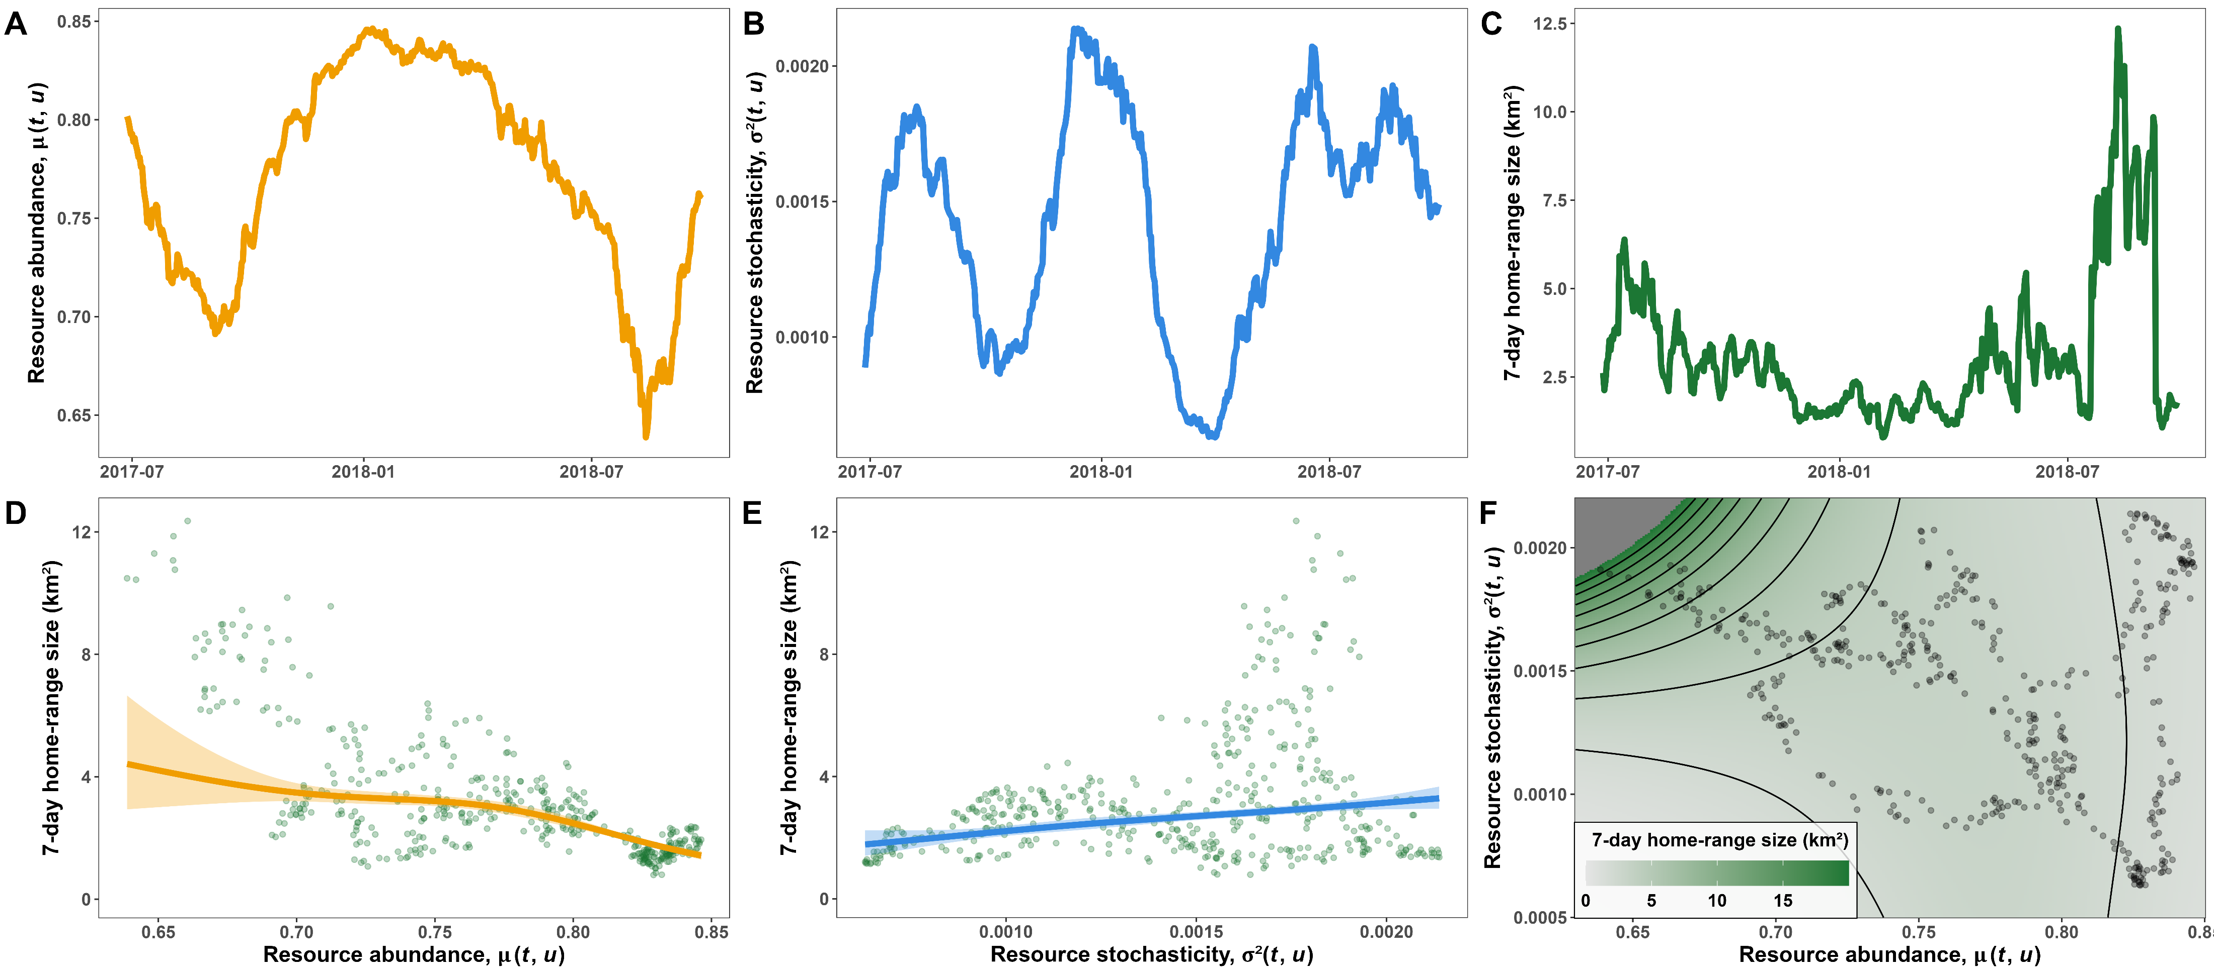
Variance of NDVI is a useful proxy
Fig. from repo of Mezzini et al. (2025) https://doi.org/10.1186/s40462-025-00546-5

Slide 9
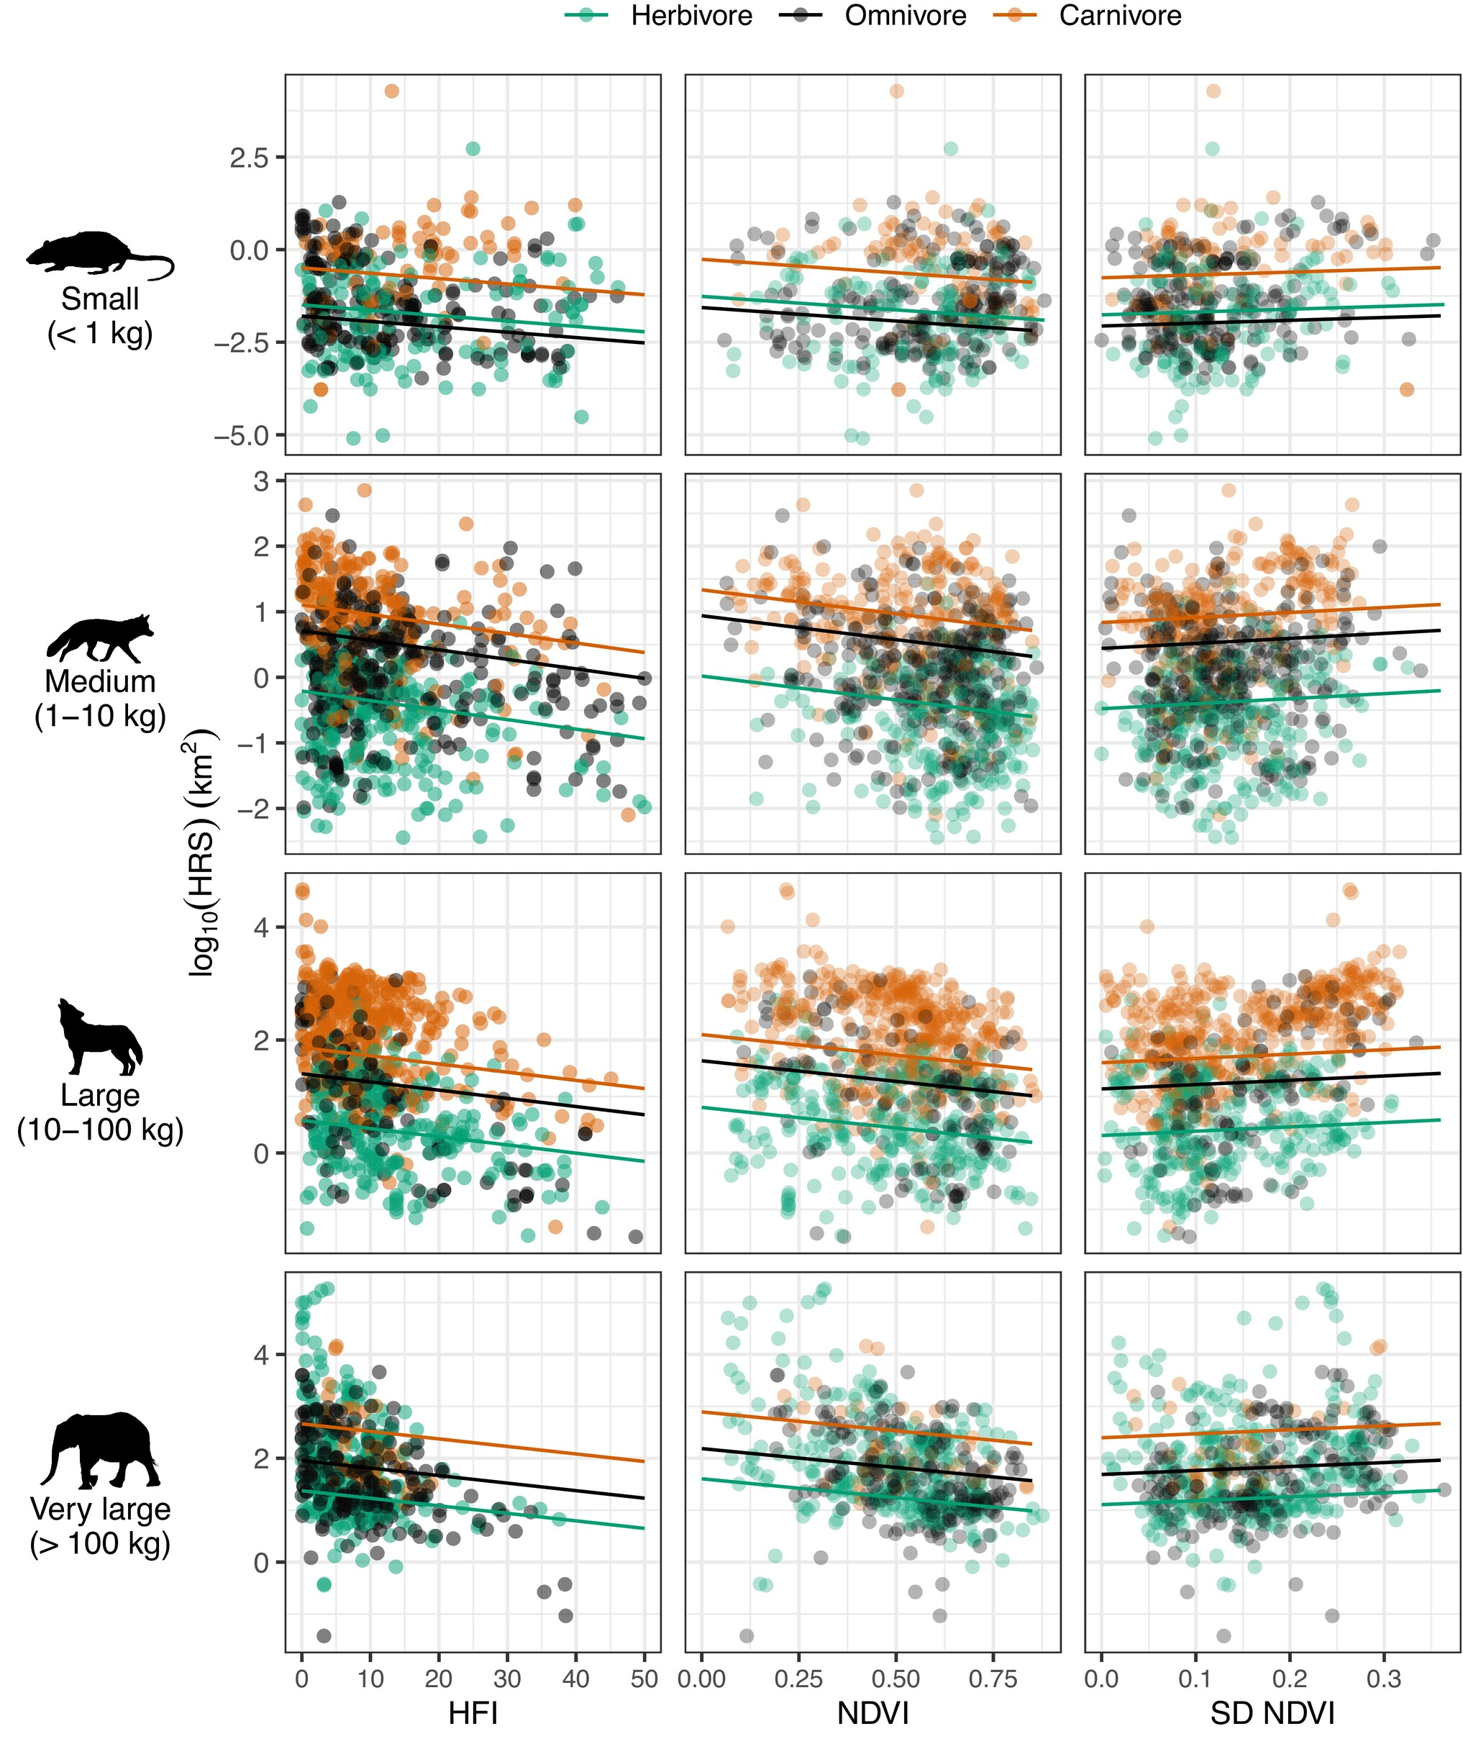
Var(NDVI) is a useful proxy for many species
Fig. 2 from Broekman et al. (2024)
doi.org/10.1111/1365-2656.14073

Slide 10
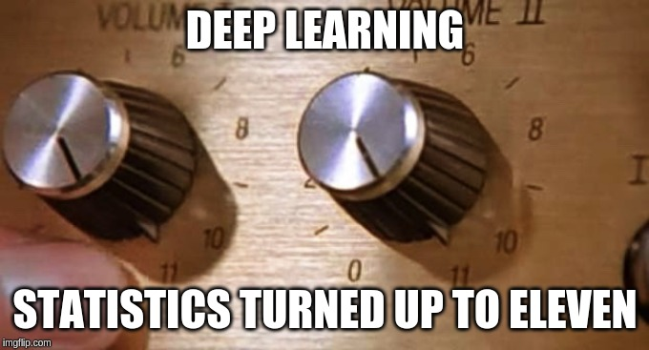
Why not just use deep learning?
Results can be highly accurate but are rarely interpretable
We need communicable models and predictions
We need sensible stats models
From Simpson, Hinz, and Mezzini (2019)

Slide 11
GAMs: flexible yet interpretable models
From Simpson, Hinz, and Mezzini (2019)

Slide 12
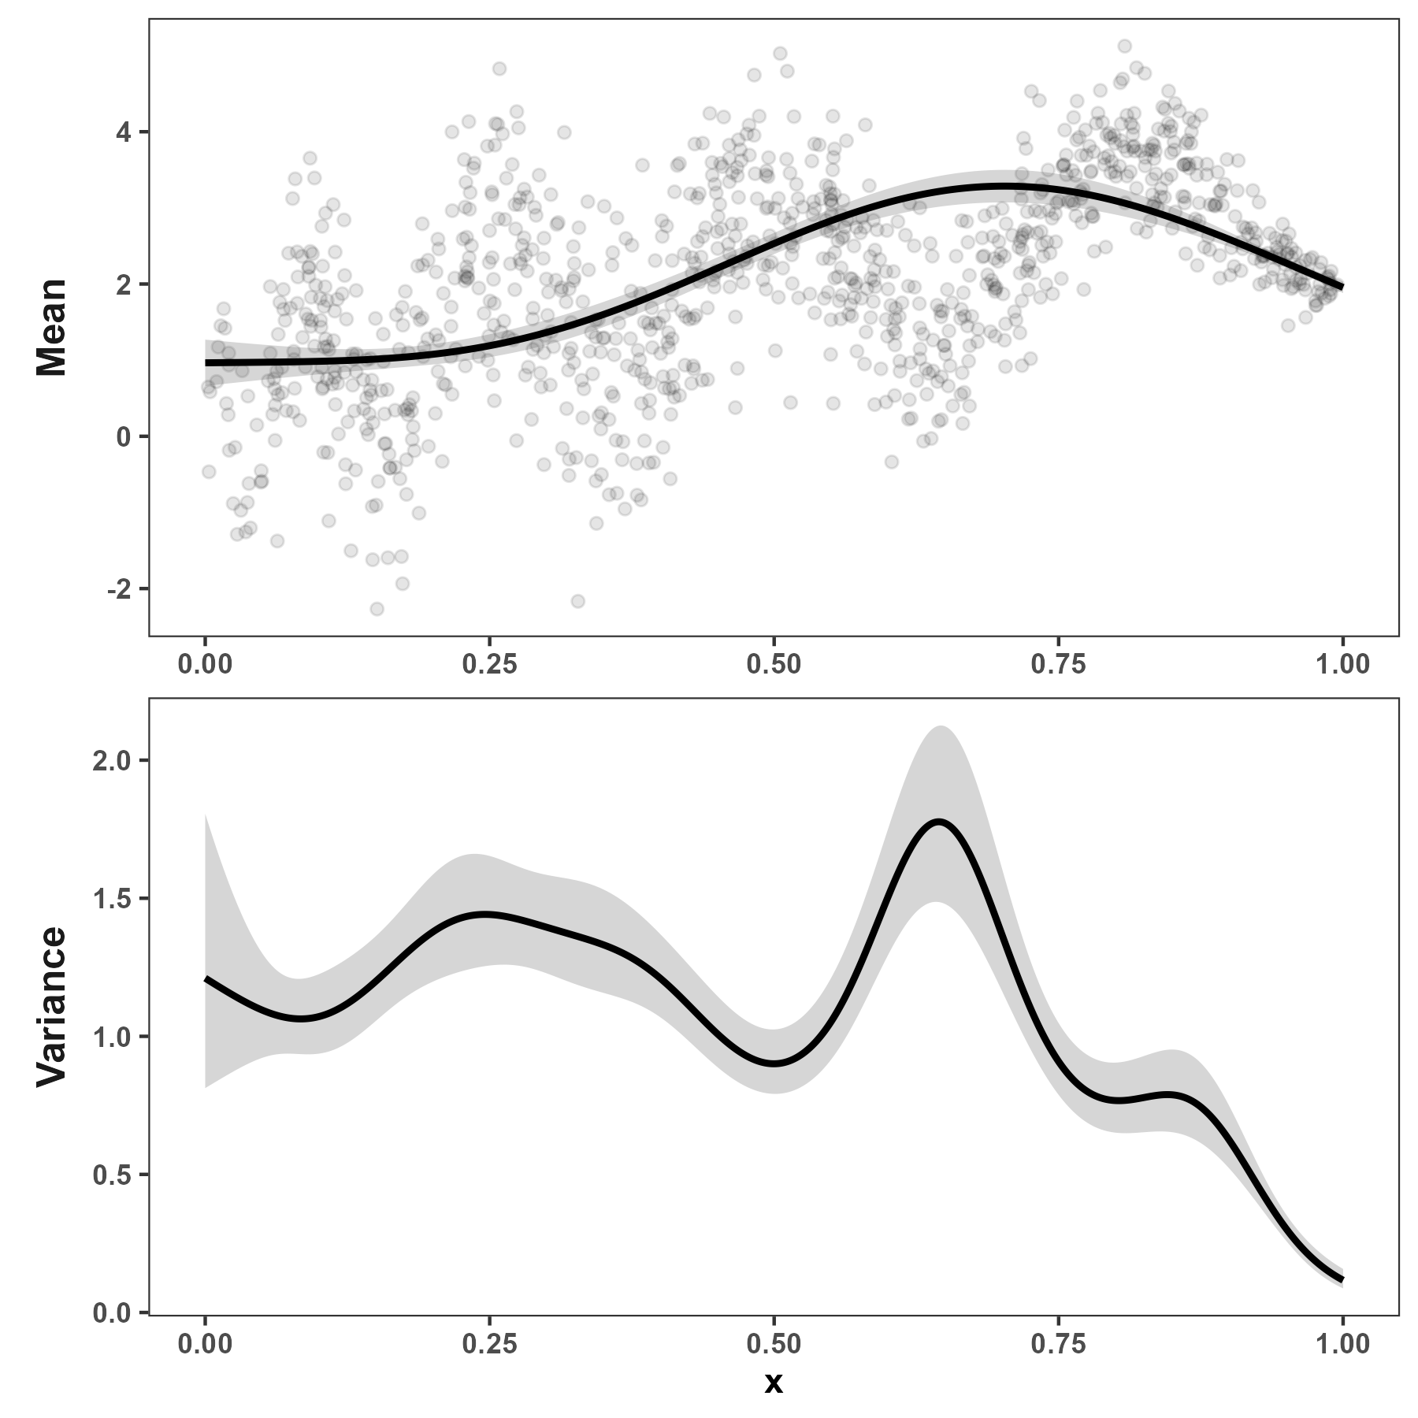
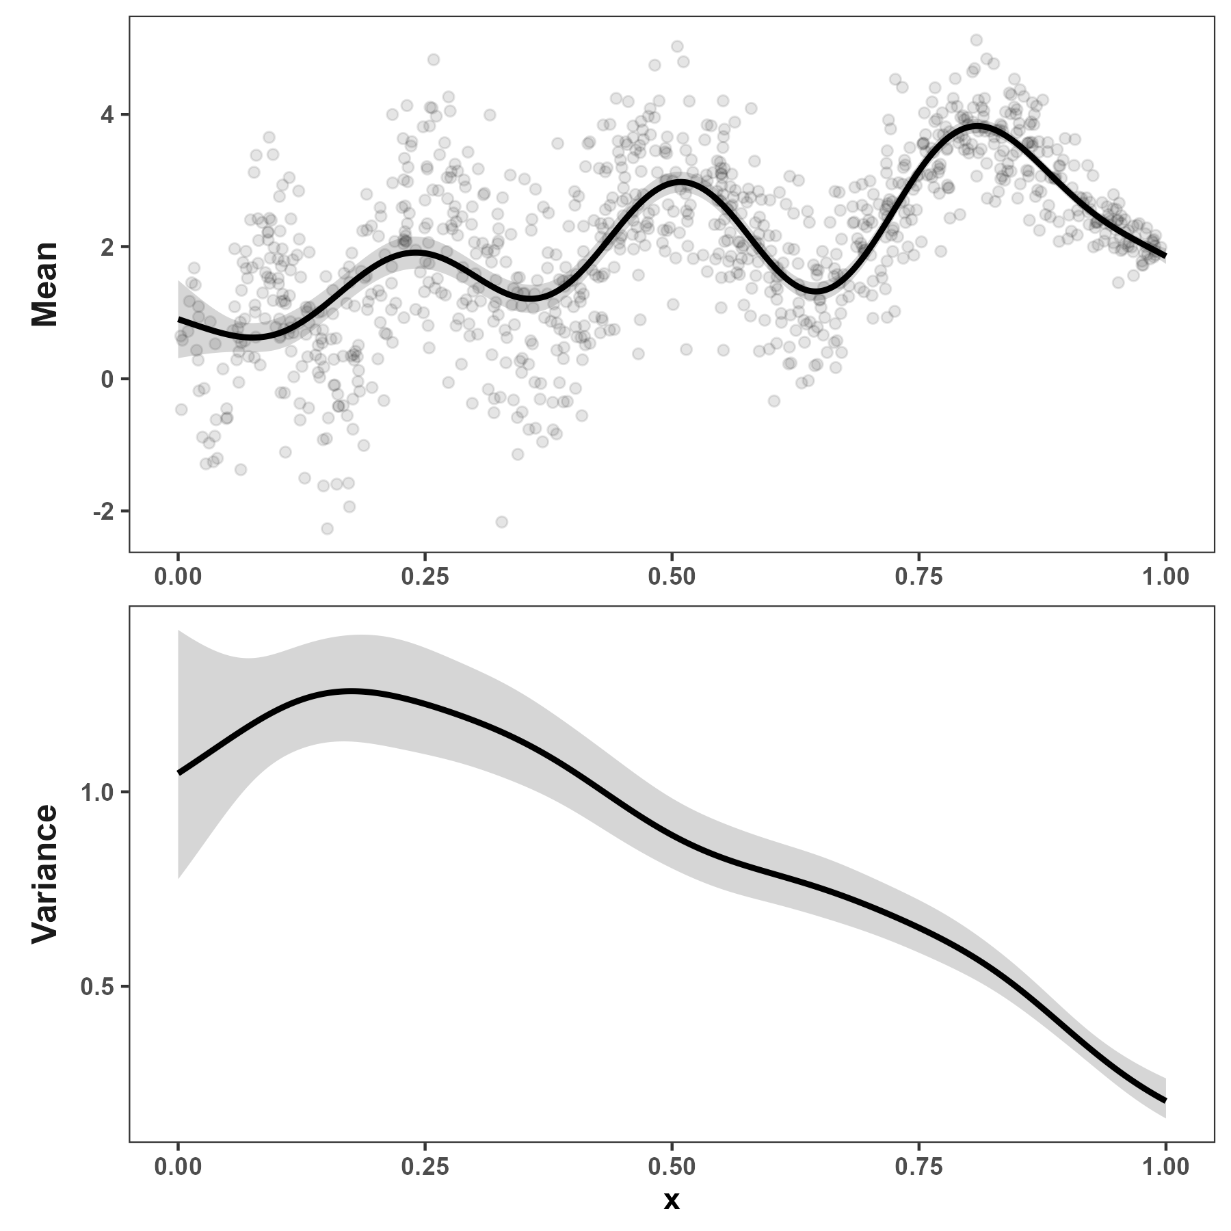
Variance estimate depends on mean estimate
Smooth mean gives large, wiggly variance
Wiggly mean gives small, smooth variance

Slide 13
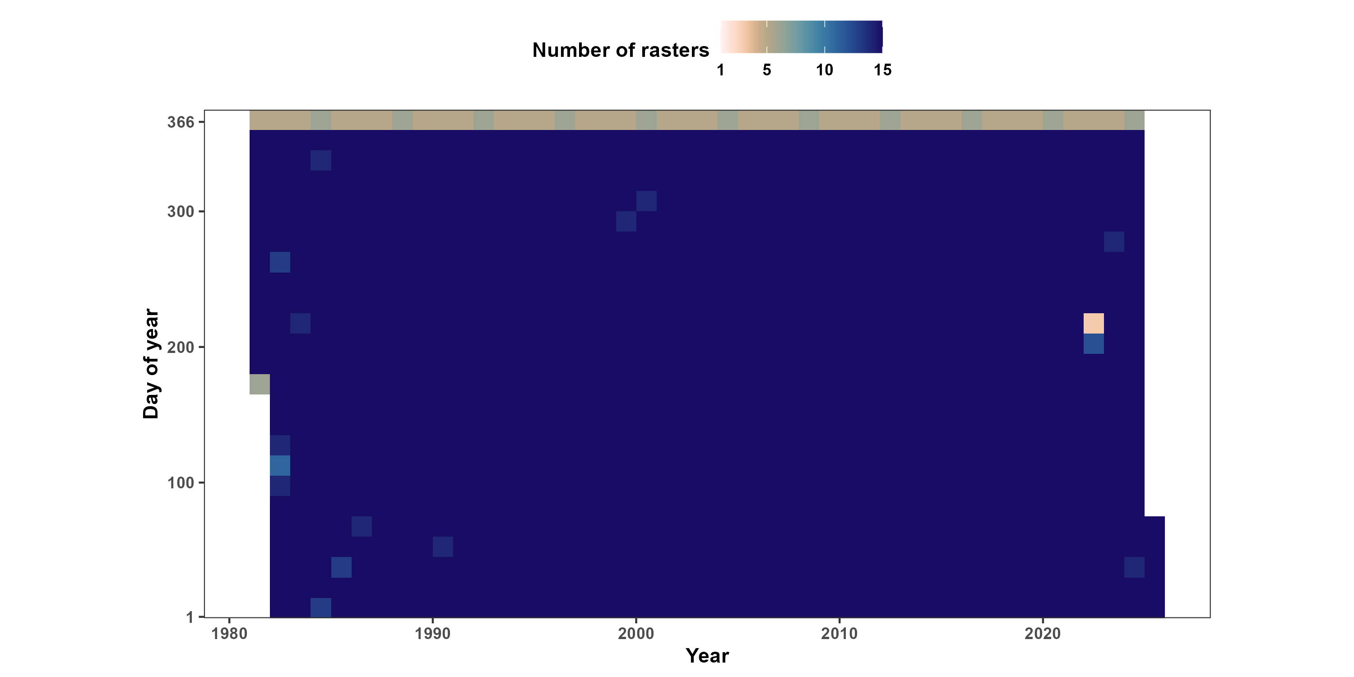
AVHRR/VIIRS: daily NDVI data at a 0.05° resolution

Slide 14
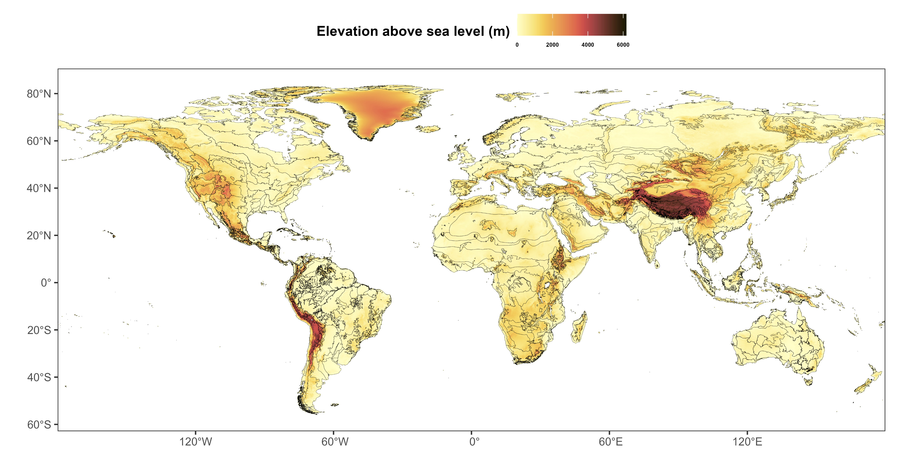
A global digital elevation model (DEM)

Slide 15
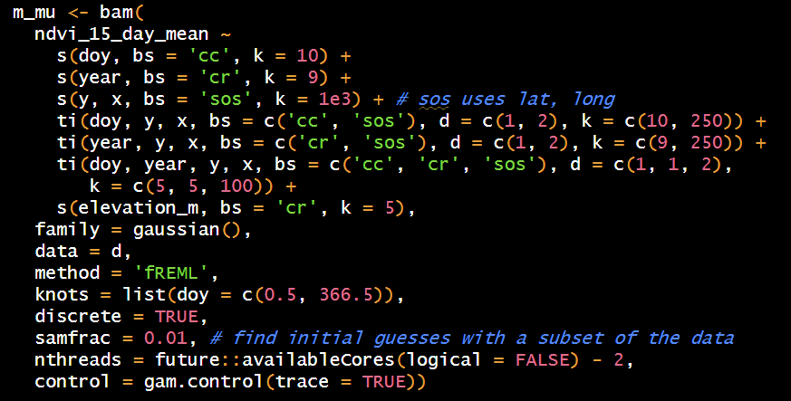
Estimating mean NDVI

Slide 16
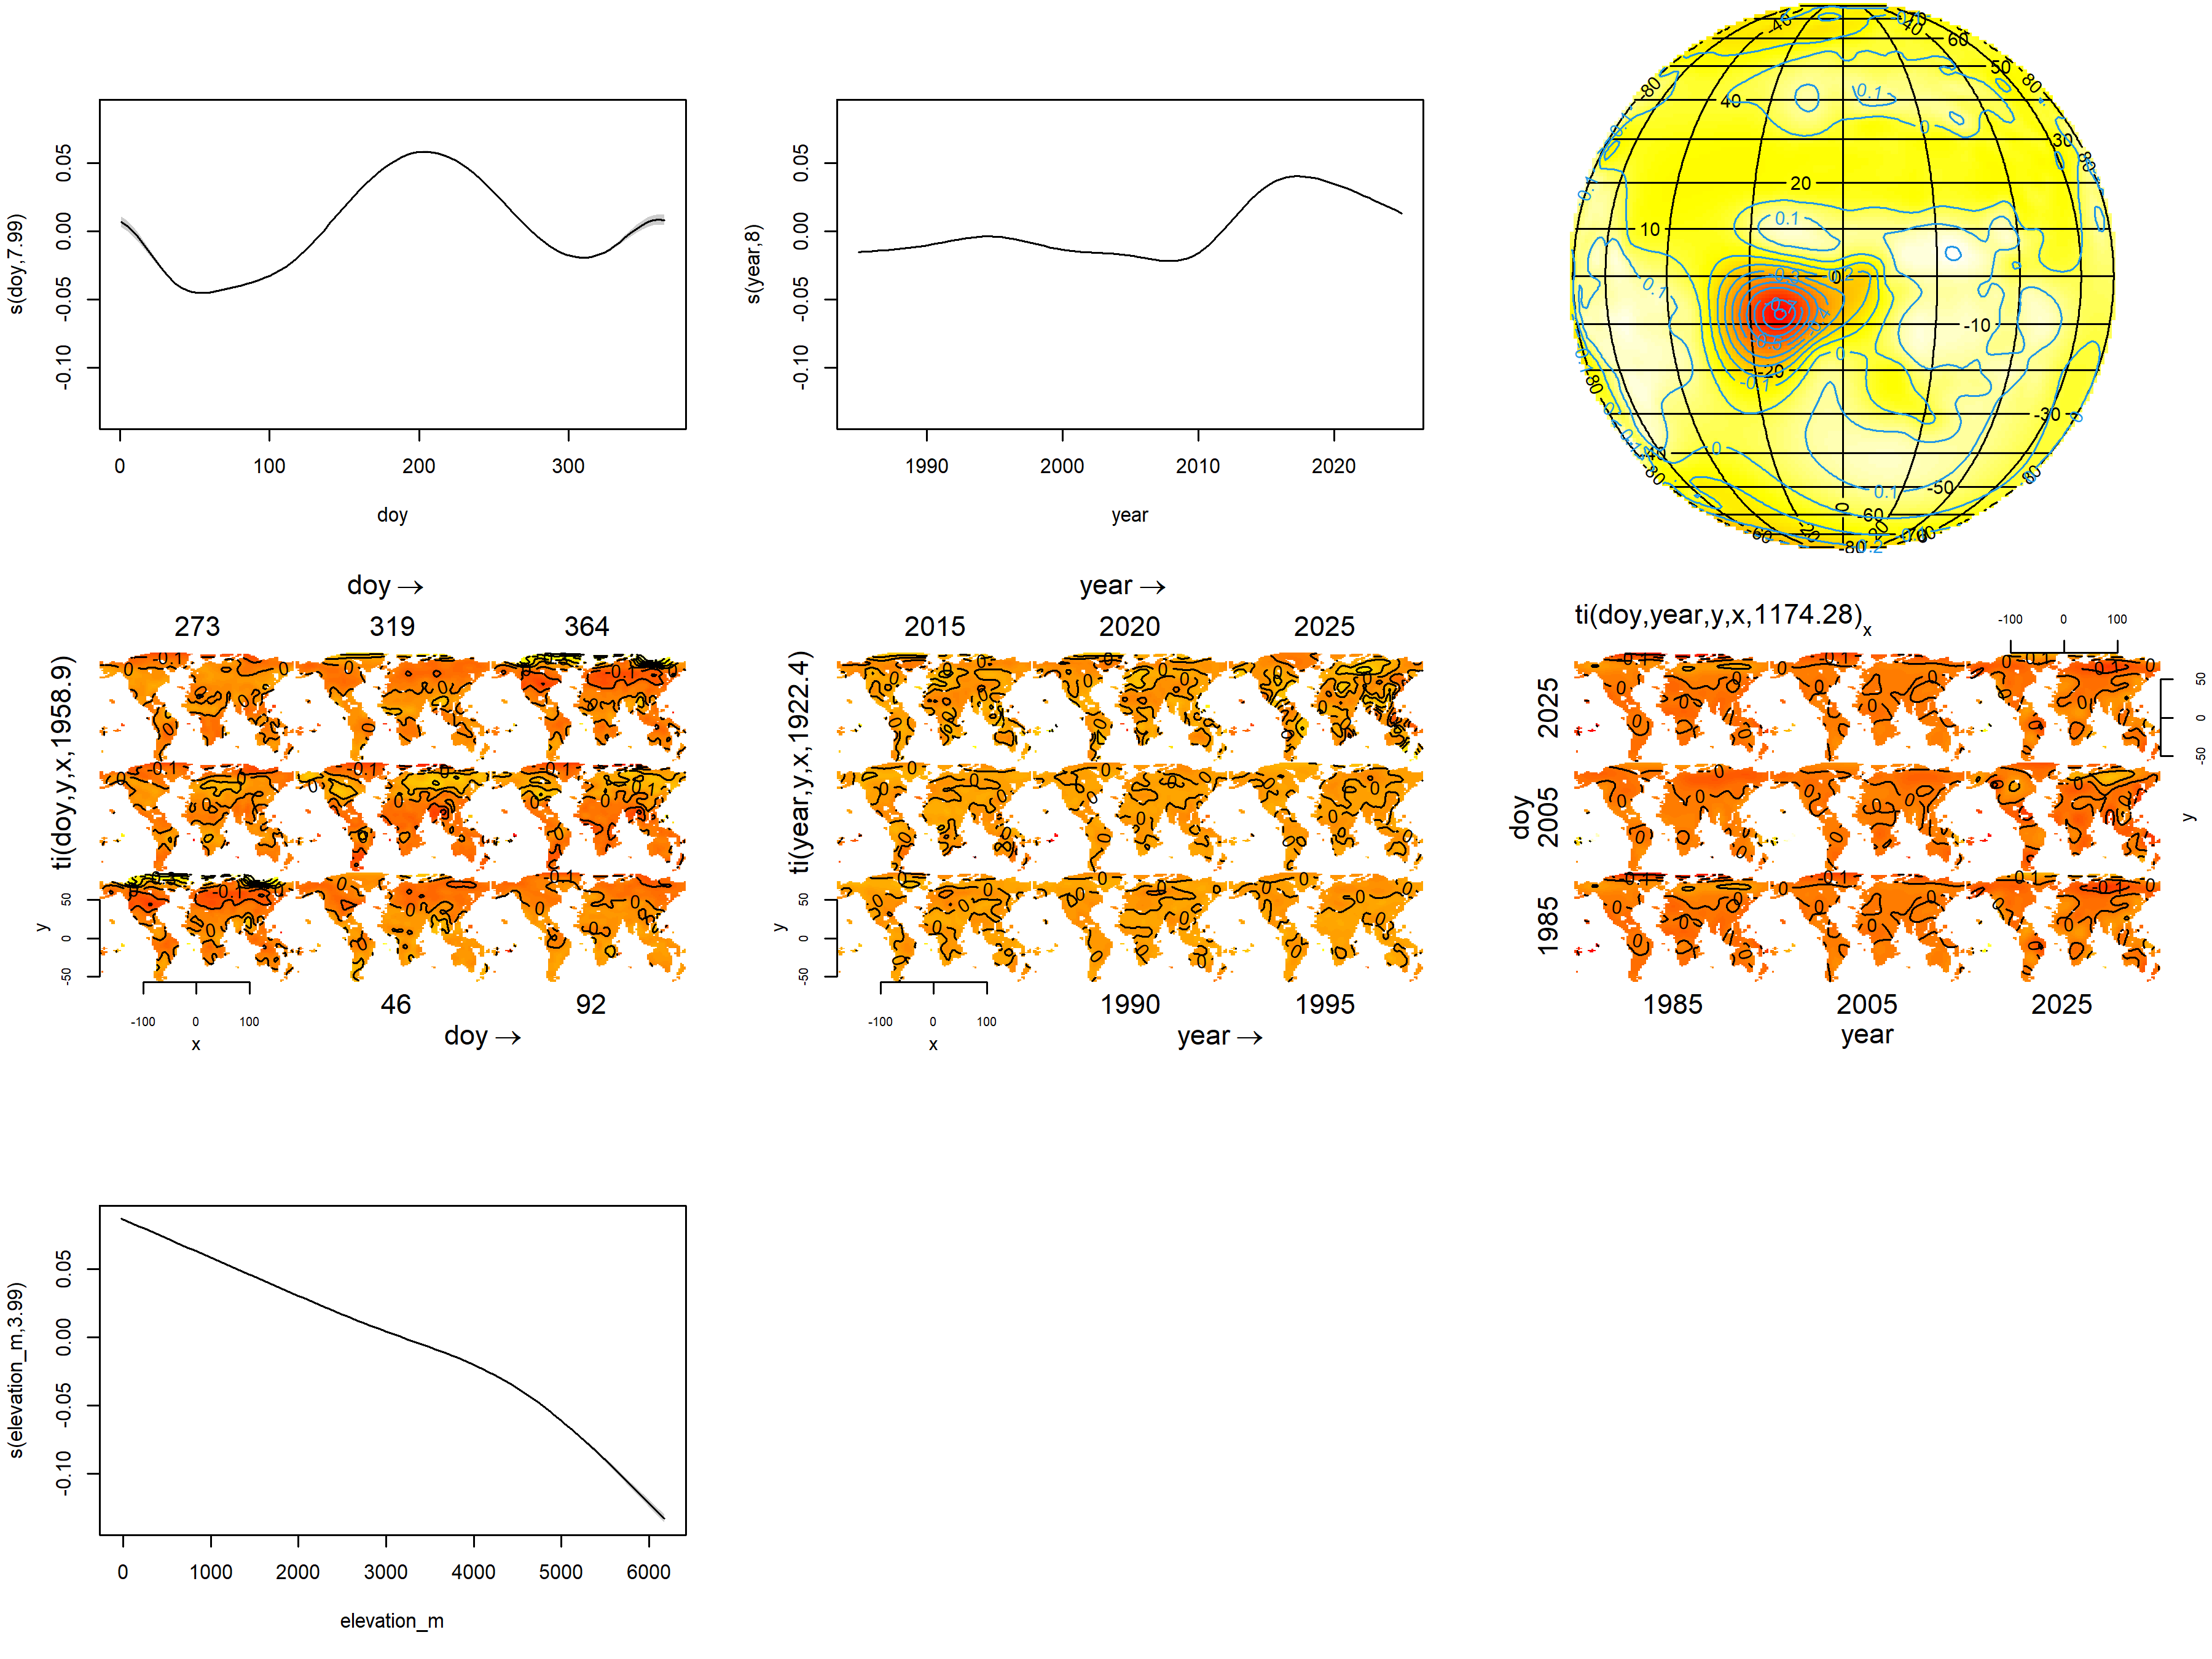
Estimating mean NDVI

Slide 17
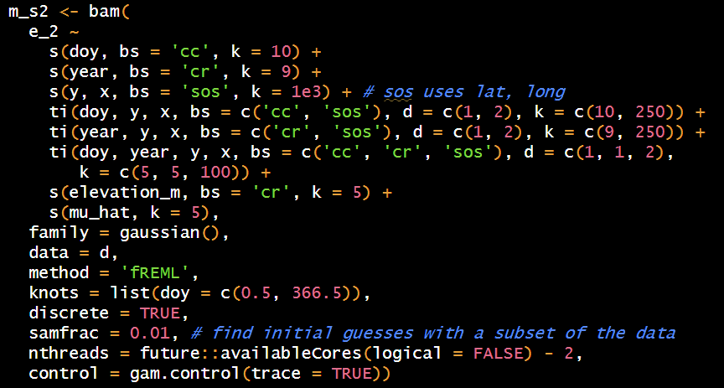
Estimating variance in NDVI

Slide 18
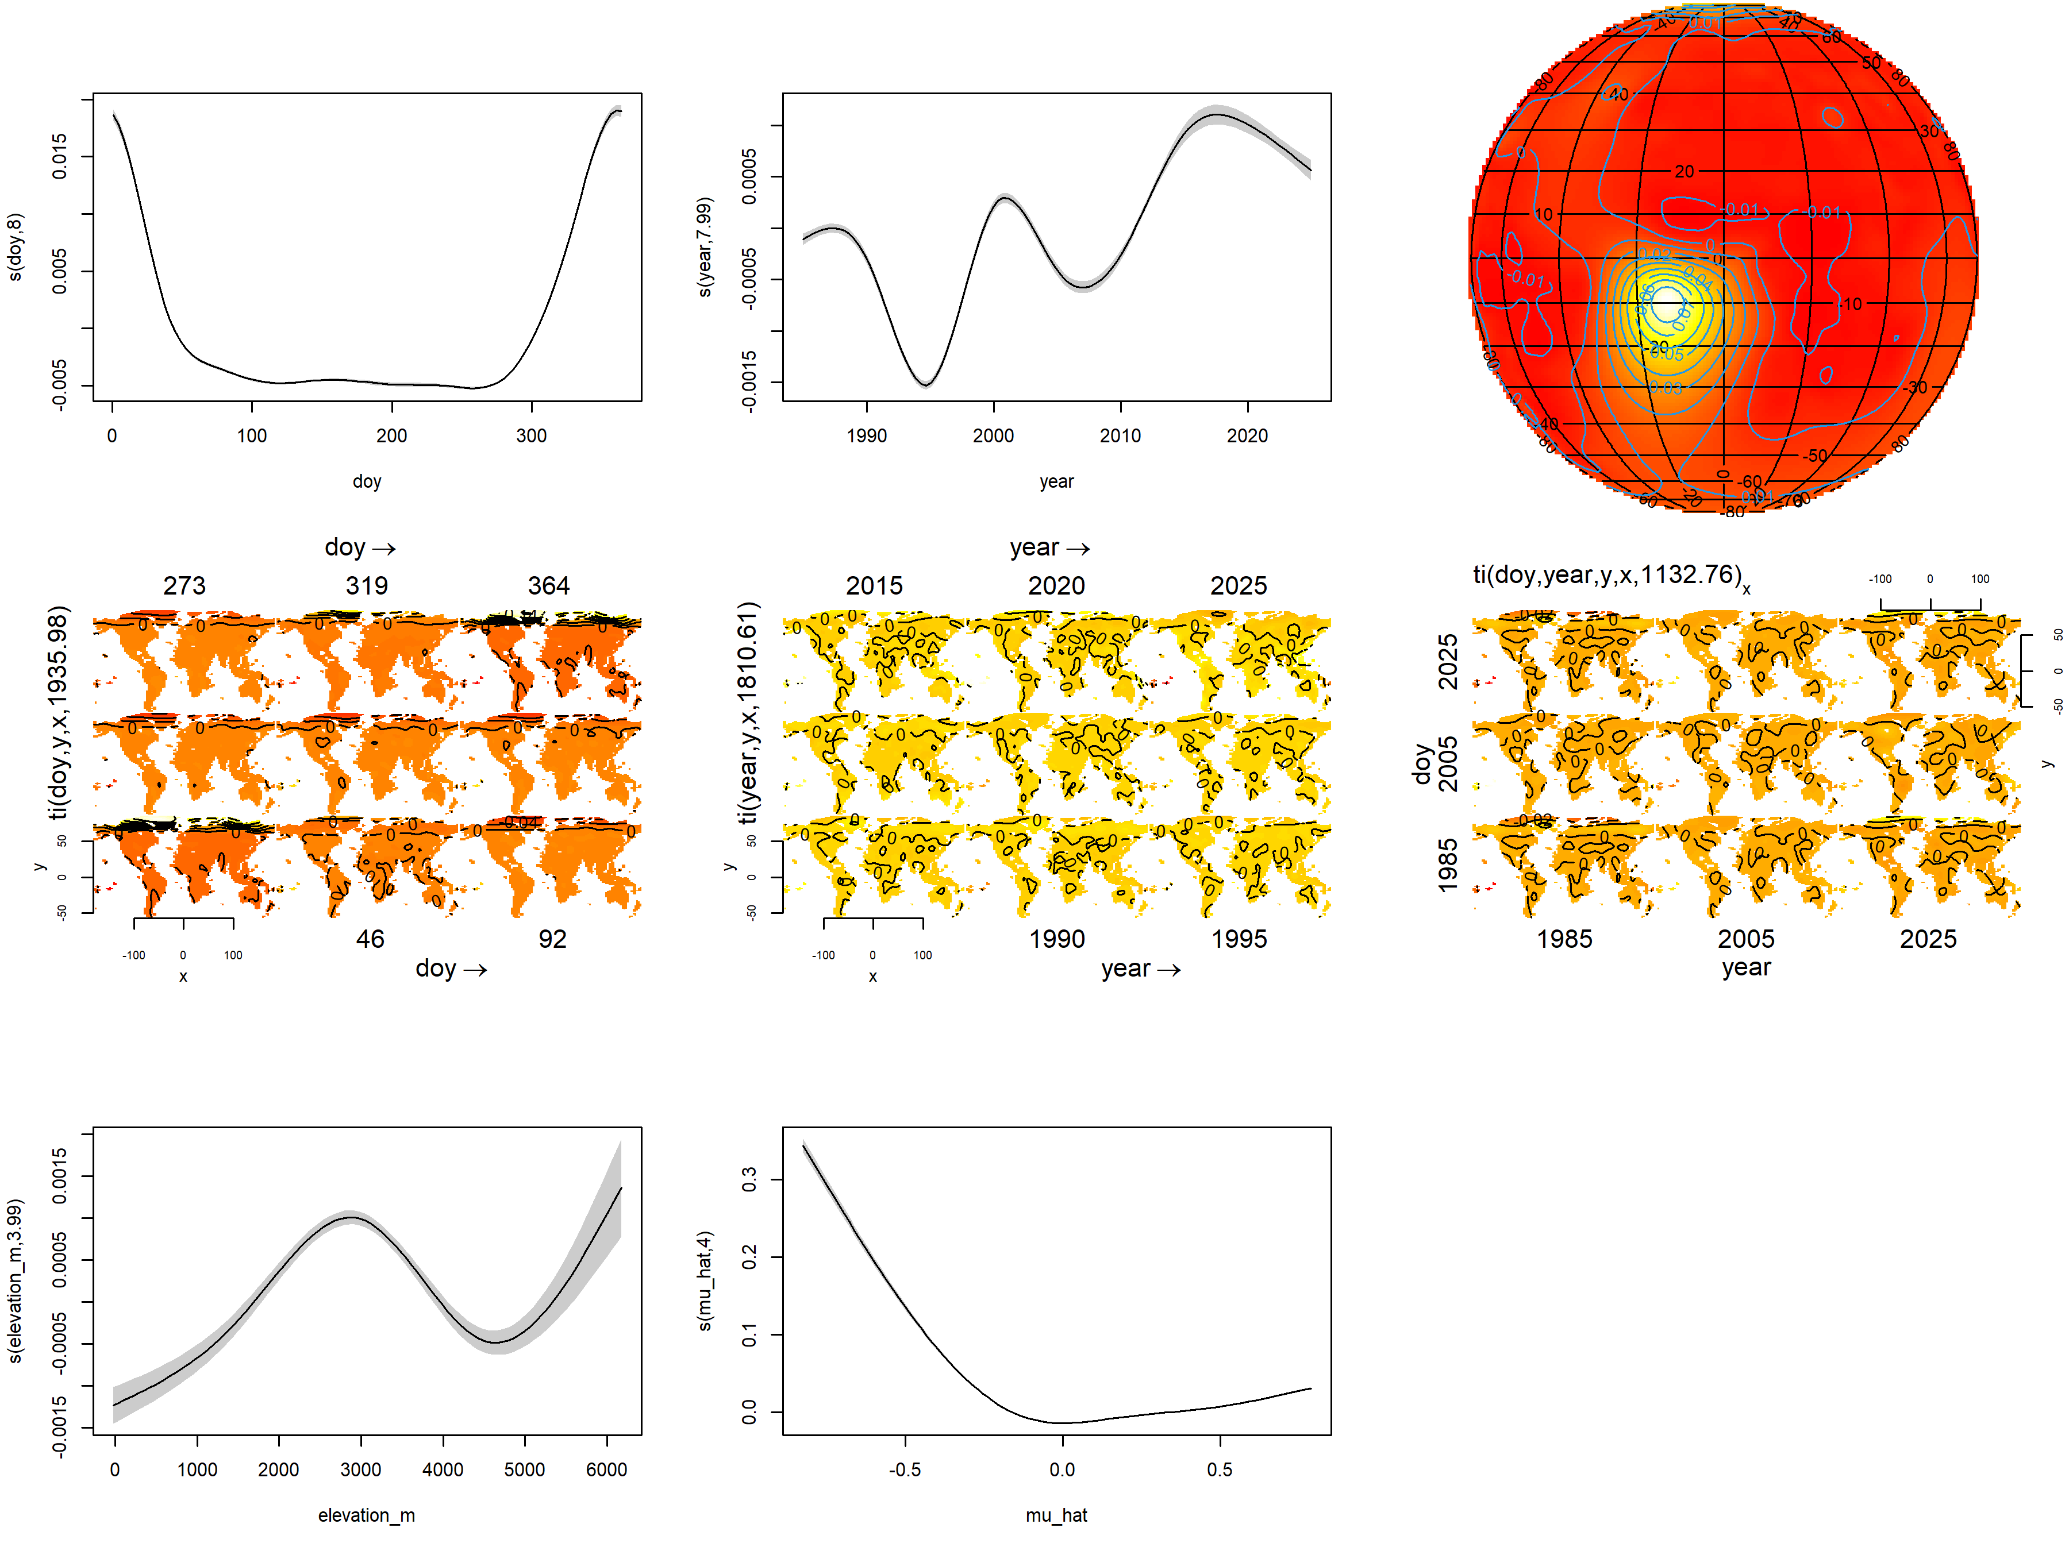
Estimating variance in NDVI

Slide 19
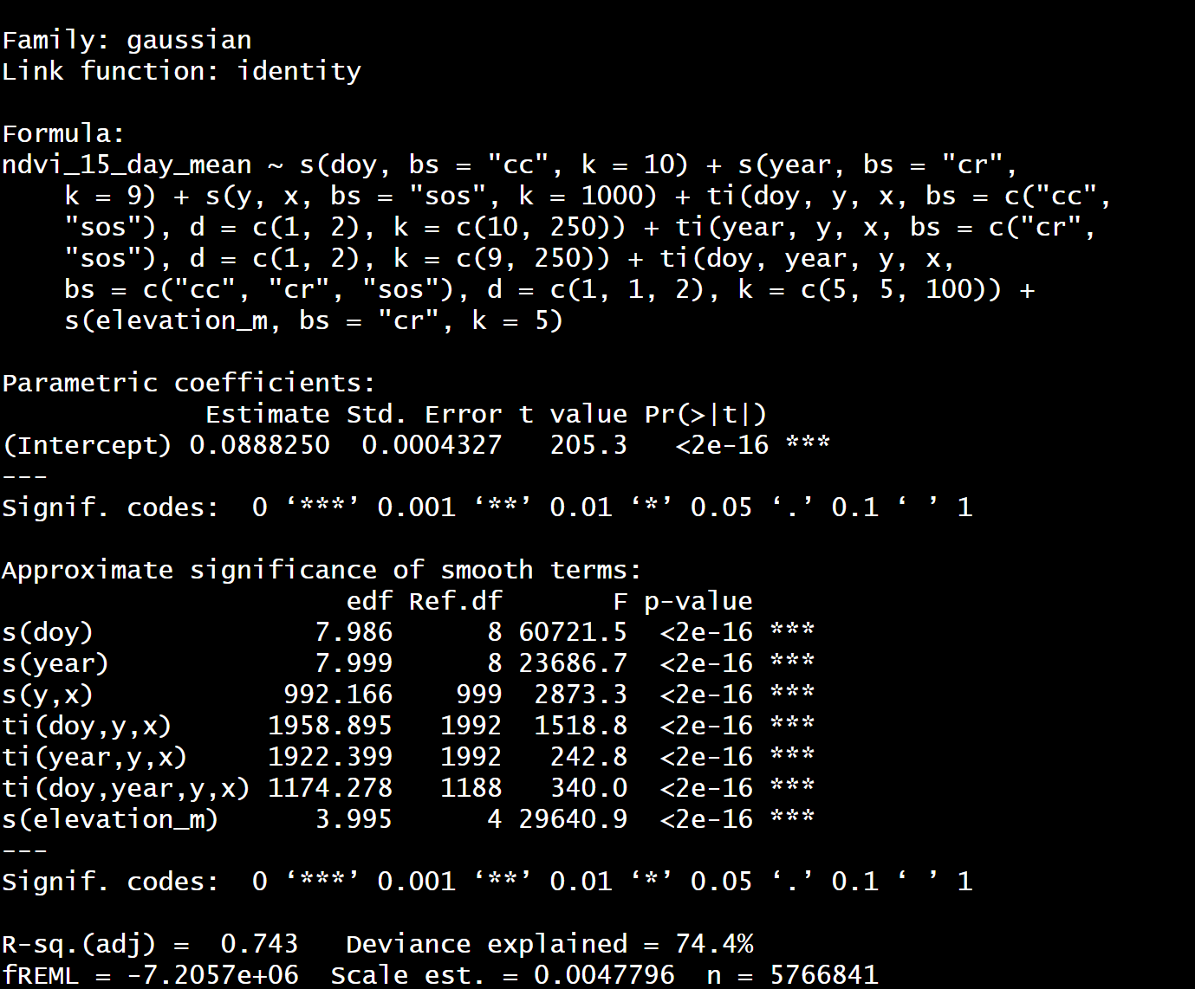
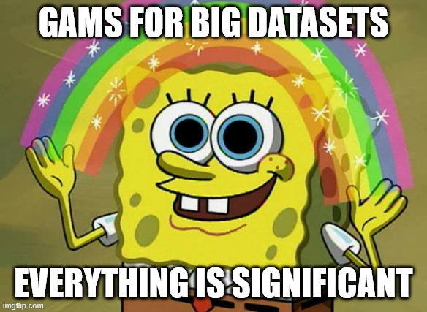
Model statistics for nerds
Deviance explained: Mean : 74.4%; Variance: 14.%

Slide 20
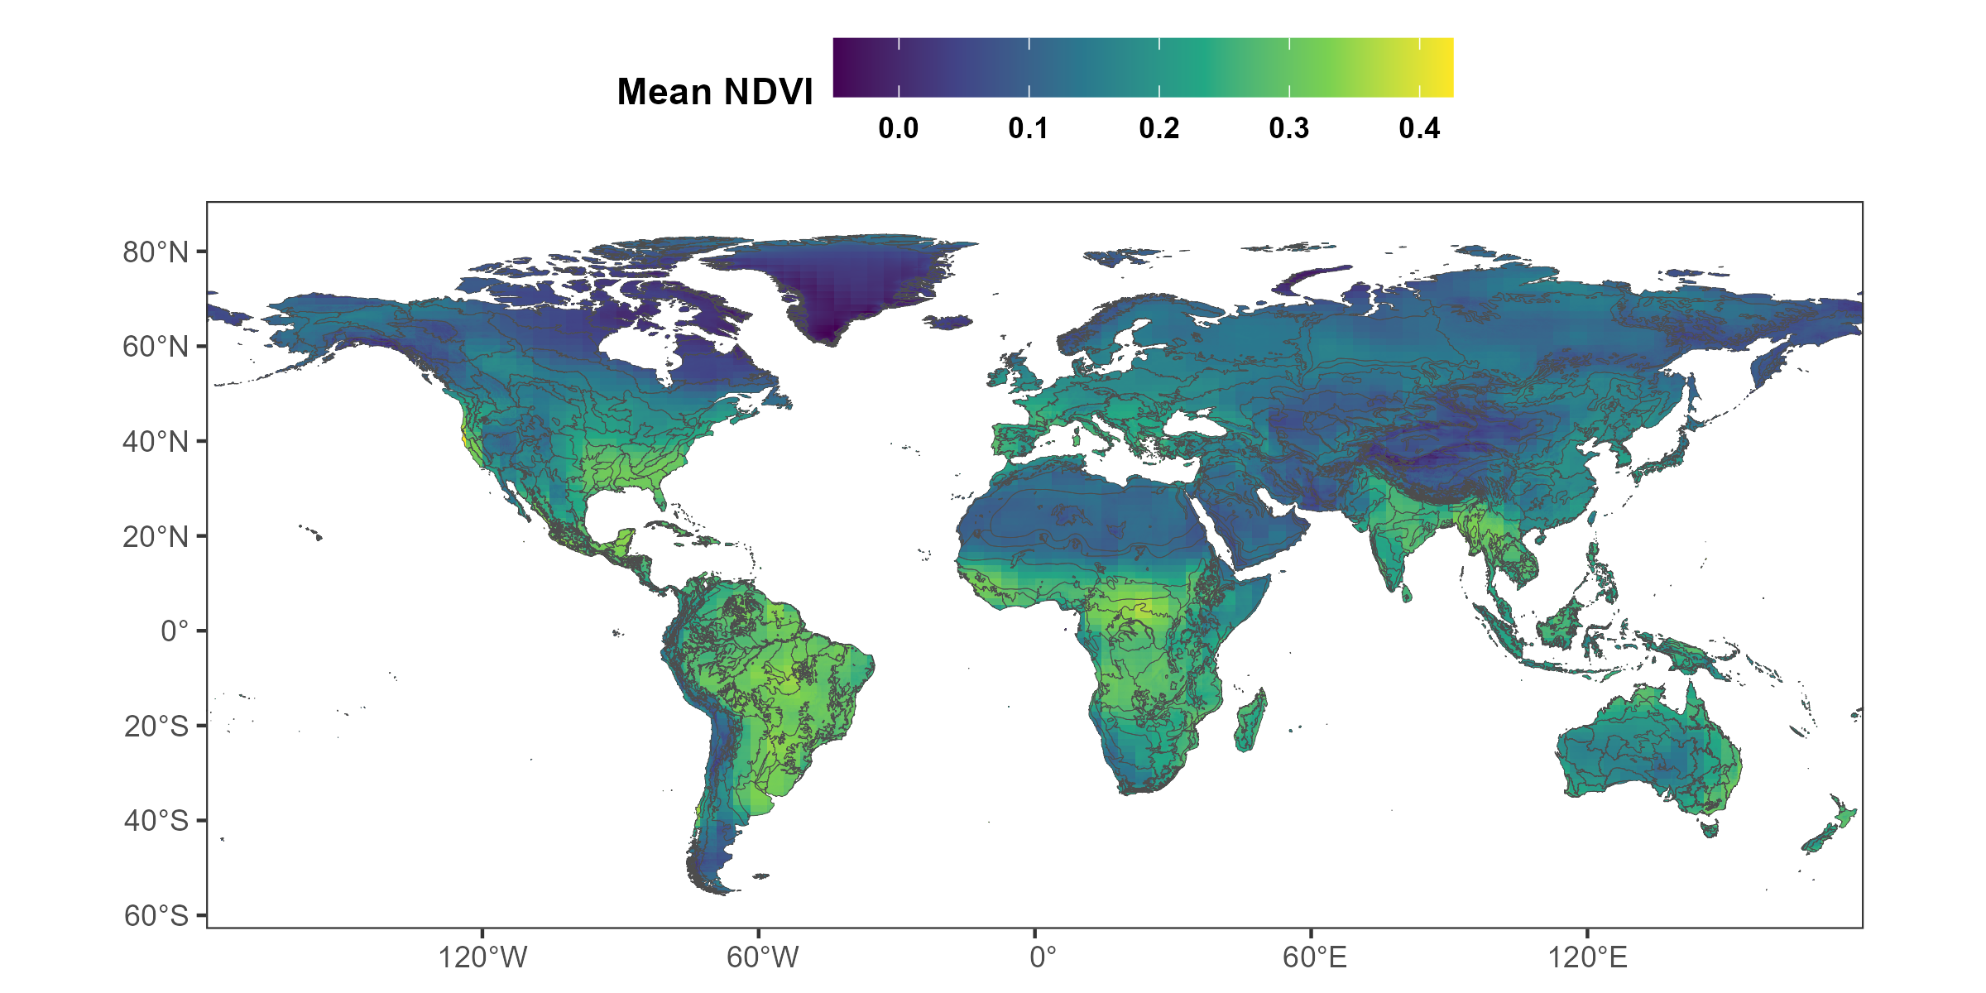
Model predictions: Mean NDVI

Slide 21
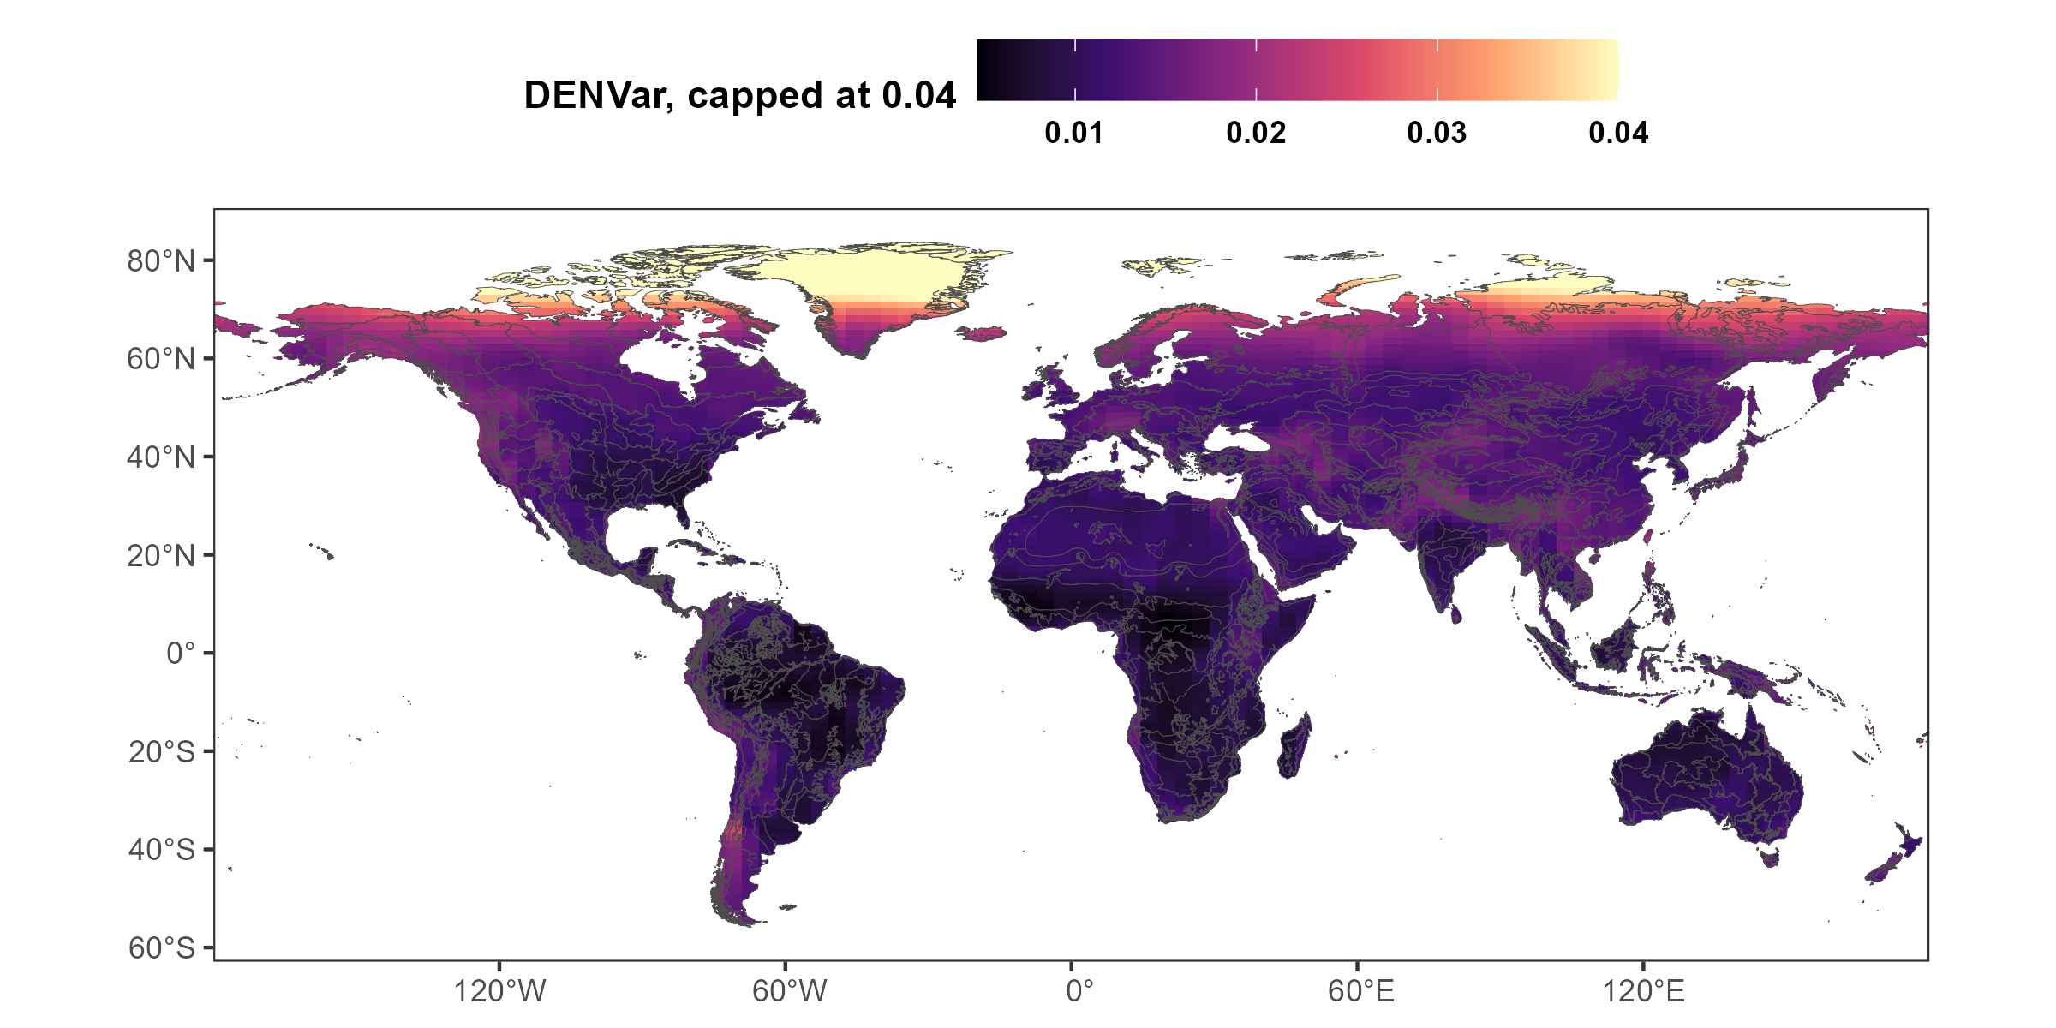
Model predictions: DENVar

Slide 22
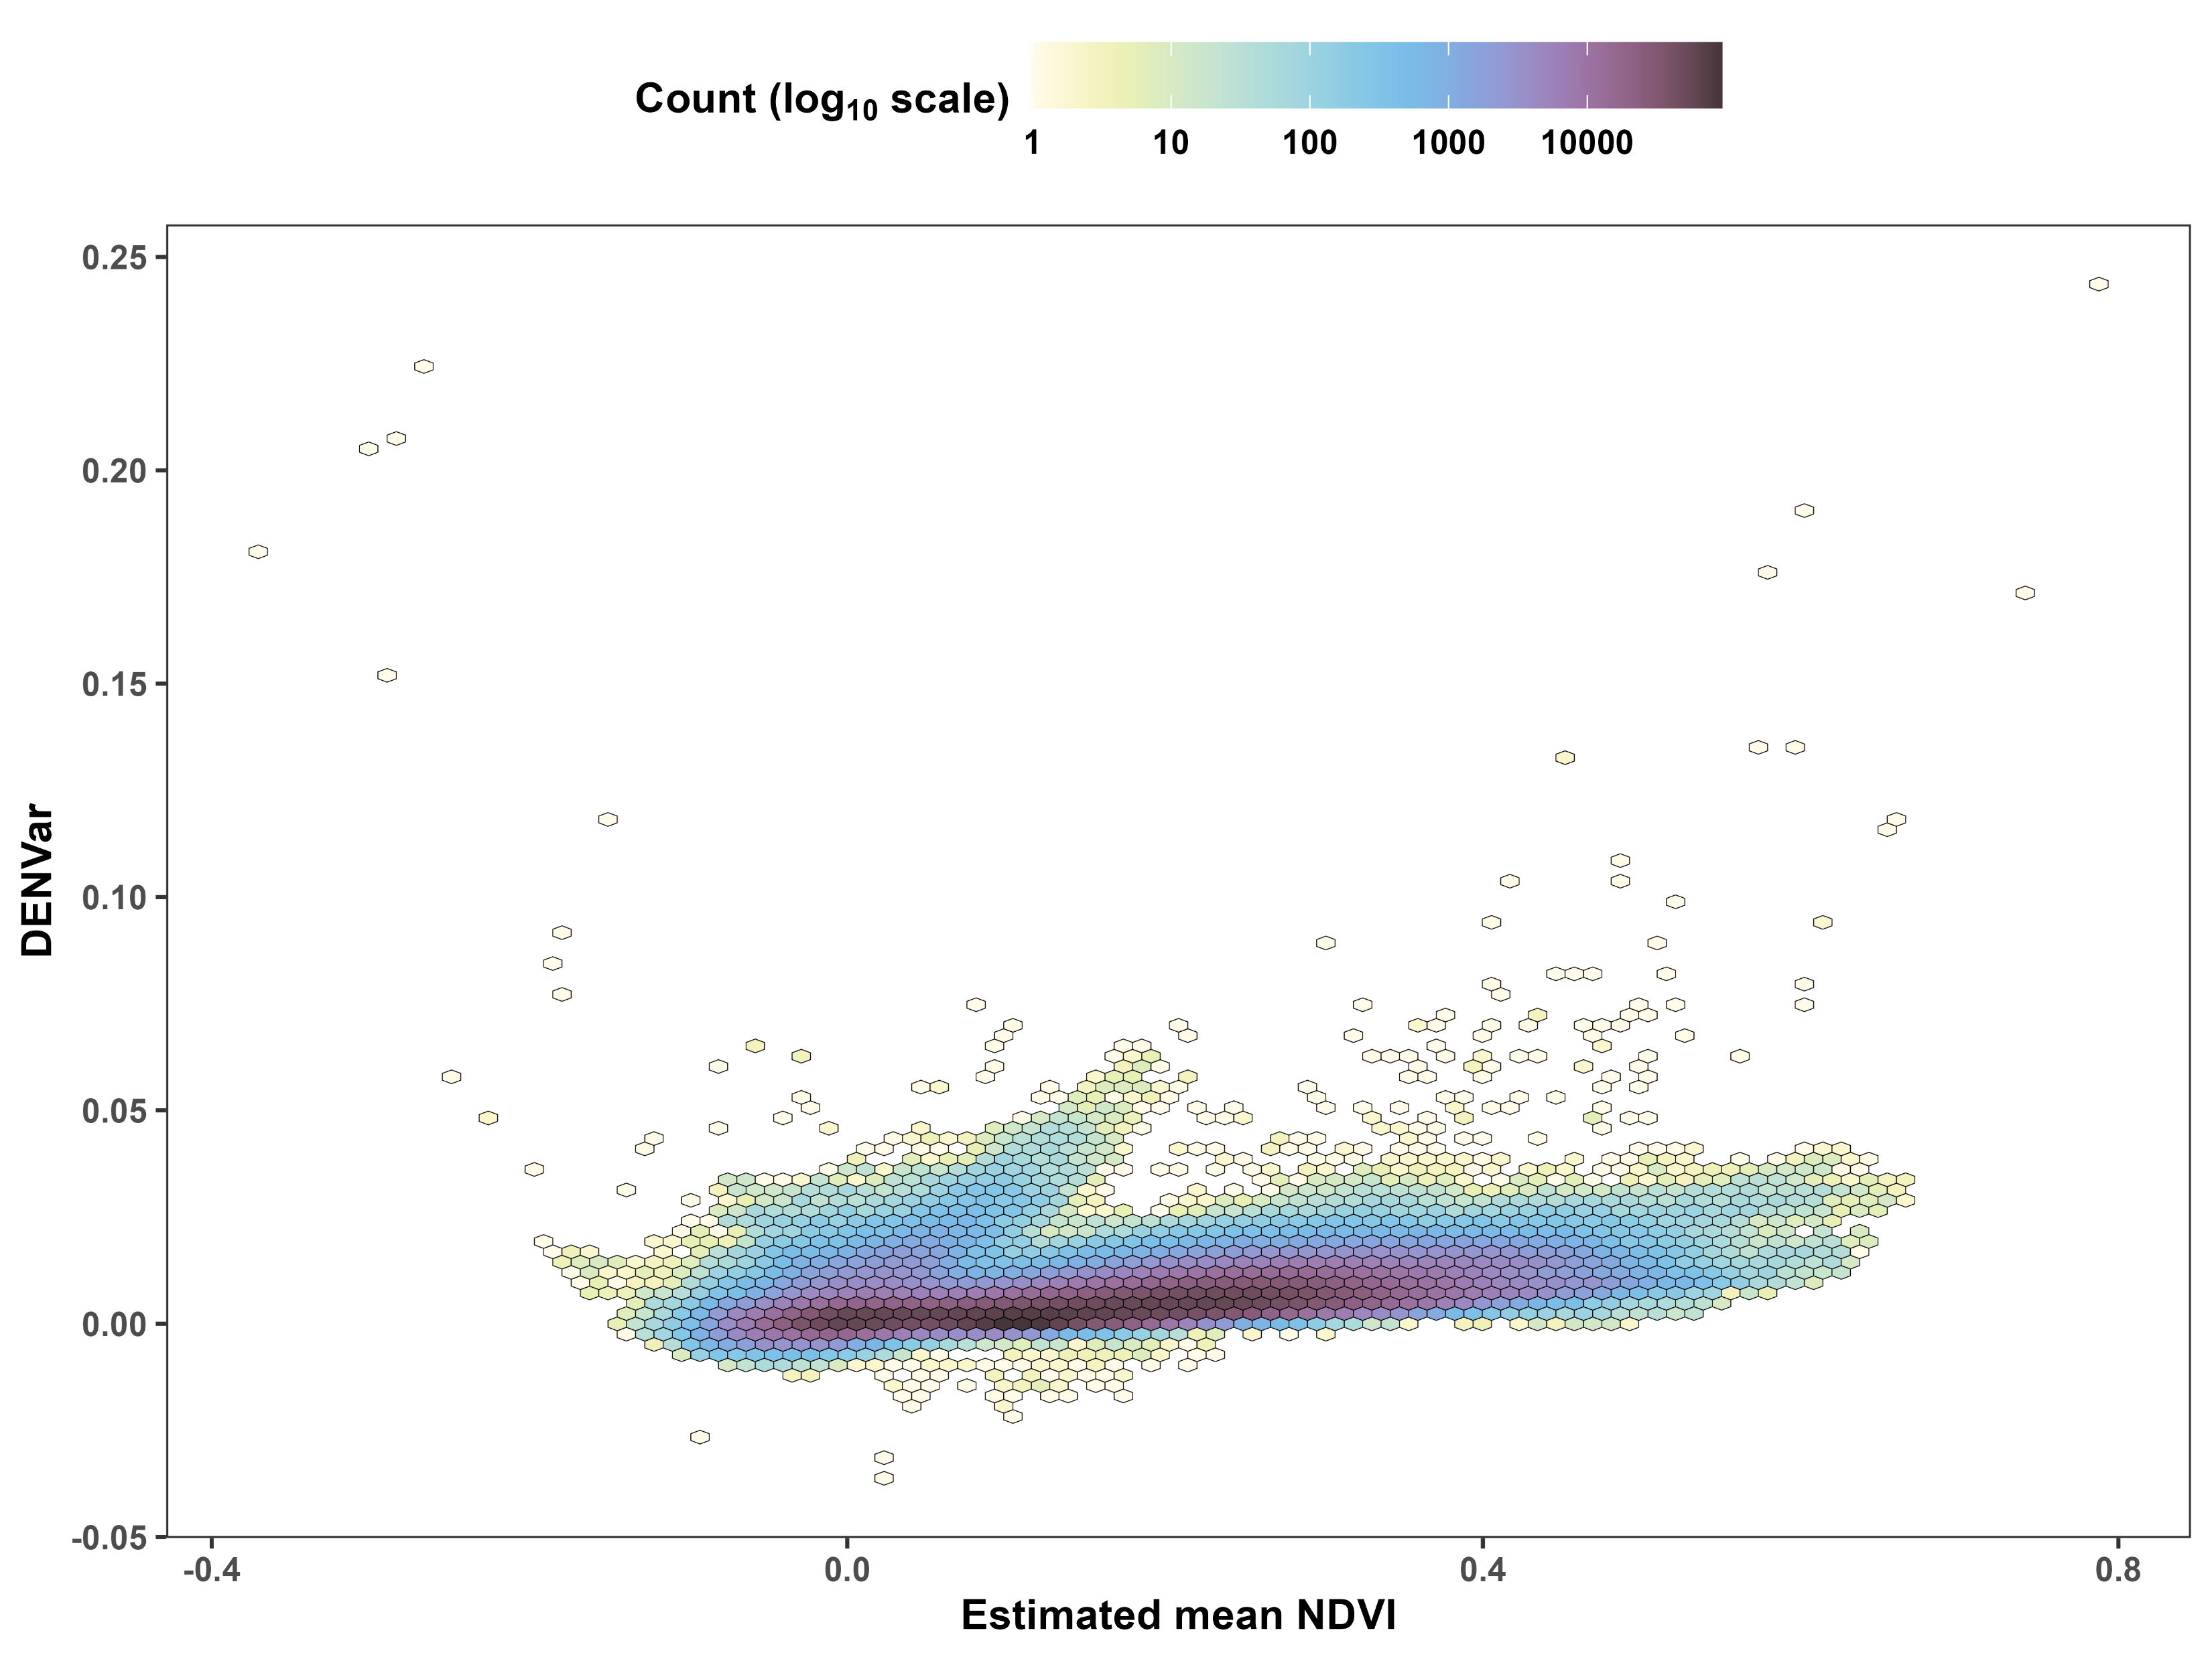
Mean and variance of NDVI are correlated

Slide 23
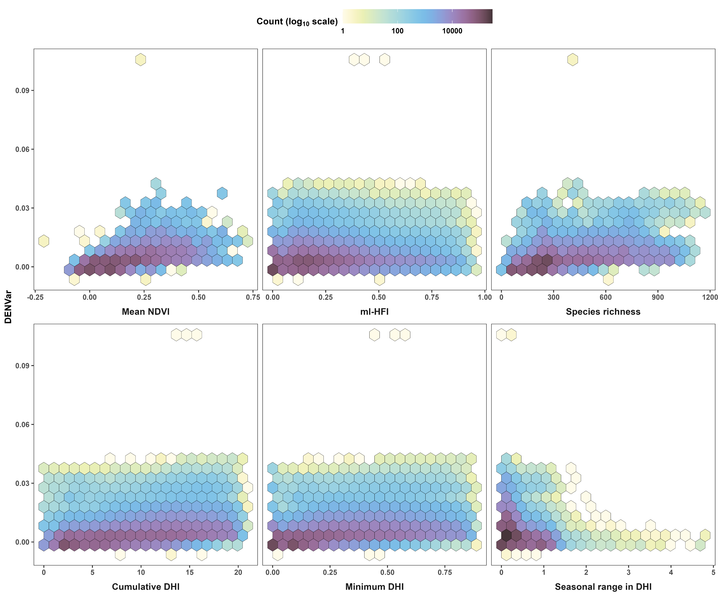
DENVar is correlated with other metrics, too

Slide 24
Why is environmental stochasticity important?
Environmental stochasticity affects:
Plant and animal phenology (e.g., timing of flowering or migration)
Animals’ movement behavior (Mezzini et al. 2025)
Species’ ability to respond to change (Botero et al. 2015)
Extreme events, which play crucial roles in ecology and evolution (Anderson et al. 2017, Logares at al. 2012)
A landscape’s energetic balance and species’ ability to adapt (Lande 1993; Chevin et al. 2010)
Forest regeneration following fires or cutting (Daniella’s work)
Forest fire occurrence (Avery’s work)

